Slide 1












Official (Closed) - Non Sensitive
PROGRAMMING
FUNDAMENTALS
Local Storage
DIPLOMA IN FULL-STACK DEVELOPMENT
Certificate in Computing Fundamentals
Continuing Education & Training (CET)

Slide 2
Official (Closed) - Non Sensitive
INTERACTIVE DEVELOPMENT
LOCAL STORAGE
Types of Storage
Cookies, Local Storage
Using Local Storage
JSON, set/get LocalStorage items
Notes:
We are going to talk about the key storage types on a browser

Slide 3


WEB STORAGE API LOCAL STORAGE
Official (Closed) - Non Sensitive
Source: https://www.w3.org
Notes:
storage and session storage are sometimes called web storage or DOM storage, DOM standing for Document Object Model.

Slide 4
Local Storage
Official (Closed) - Non Sensitive
TL;DR
HTML5 Storage is based on named key/value pairs. You store data based on a named key, then you can retrieve that data with the same key. The named key is a string.
The data can be any type supported by JavaScript, including strings, Booleans, integers, or floats. However, the data is actually stored as a string.
If you are storing and retrieving anything other than strings, you will need to use functions like parseInt() or parseFloat() to coerce your retrieved data into the expected JavaScript data type.
Notes:
HTML storage works in a simple way based on a key value pair combination.
They can store any data type however, everything will be stored as a string value only

Slide 5
Web storage (or HTML5 storage) lets you store data in the browser.
The data it stores can only be accessed by the domain that set the data.
Official (Closed) - Non Sensitive
Notes:
HTML5 storage allows us to store data in the browser, however it can only be accessed by the same domain set that it came from

Slide 6
There are two types of storage: local and session storage.
They are implemented using the localStorage and sessionStorage objects.
Commonly used in place of cookies
Official (Closed) - Non Sensitive
Notes:
Two key types of storage. Local storage and session storage.
In our module, we will solely use local storage only

Slide 7
Both local and session storage have the same methods to get and set data, but each lasts a different amount of time.
Official (Closed) - Non Sensitive
Notes:
Both local and session versions have the same way to retrieve information or set information.
The key difference is the amount of time stored

Slide 8
Official (Closed) - Non Sensitive
STORAGE LOCAL SESSION
Stored when tab closed Y N
All open windows / tabs Y N
can access the data
Notes:
One of the main advantages of localstorage is, when you close your browser or tabs, and reopen them later, the localstorage information will still persist and exist

Slide 9
Official (Closed) - Non Sensitive
Most browser store up to 5MB of data per domain in a storage object.
Should a site require more than the 5MB of data, typically the browser will ask the user for permission to store more data
(never rely on users agreeing to give a site more space)
Notes:
It’s pretty common that most browsers have up to 5MB allowed for data storage.
Exceeding it will be a concern too.. 5MB is a lot for just data information

Slide 10
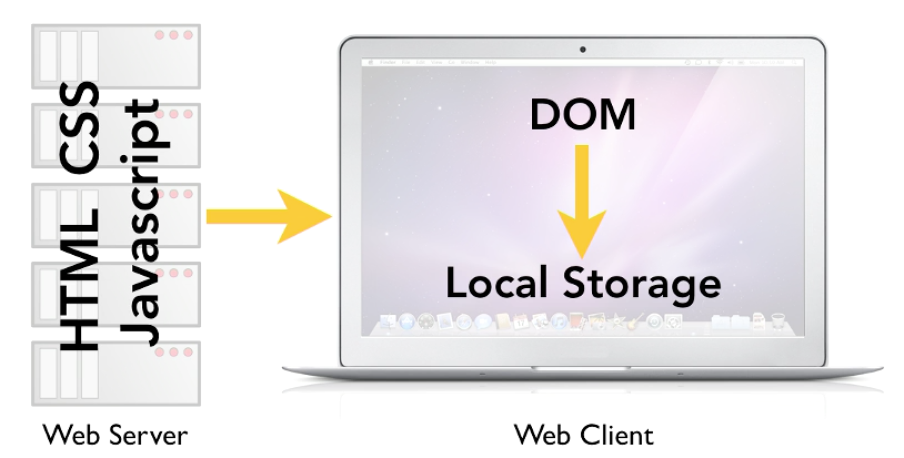
Official (Closed) - Non Sensitive
Notes:
These servers can be running any operating system and any web server software that you like.
The one thing that they all have in common is that they serve up web pages and web objects using the HTTP protocol.
The application is made of components in HTML, CSS, and JavaScript.
All of these are delivered over the standard HTTP web protocol.
The database interface is coded in JavaScript.
For reasons that will become clear in a moment, the local storage database code needs to run in the browser and JavaScript makes that possible.
All of these components, the HTML, the CSS, and the JavaScript, are requested by and delivered to the web client, typically a web browser running on a computer or a mobile device.
The web application interfaces with the client device by virtue of a technology called the Document Object Model or simply the DOM.
The DOM allows the JavaScript component to access various features on theclient, allowing interactive applications to be developed.

Slide 11
Official (Closed) - Non Sensitive
For security protection, browsers employ a same origin policy, which means that data can only be accessed by other pages in the same origin.
Sidenote: this is also how iframes are being restricted
https://developer.mozilla.org/en-US/docs/Web/Security/Same-origin_policy
Notes:
This is usually enabled on the server end and for developers that intend to embed such information, there’s not much we can do.
Meaning we can’t easily embed/iframe another source unless the source allows us to (e.g youtube embeds).
There are other ways to bypass it but that might cause a violation in the source privacy policy.

Slide 12
Official (Closed) - Non Sensitive
1. Protocol: The protocol must be a match. If data was stored by a page that starts http, the storage object cannot be accessed via https.
2. Subdomain: The subdomain name must match.
For example, maps.google.com cannot access
data stored by www.google.com
http://www.google.com: 80
2
4
1
3
3. Domain: The domain name must match.
For example, google. com cannot access local storage from facebook.com.
4. Port: The port number must match. Webservers can have many ports. Usually a port number is not specified in a URL, and the site uses port 80 for web pages, but the port number can be changed.
Notes:
Our localstorage can only exist on the same domain.
To put it simply, different webpages but of same domain and http protocol then only localstorage can persist.

Slide 13
Official (Closed) - Non Sensitive
#WEBSTORAGE #WK4
Accessing the storage API:
localStorage.setItem(key, value)
sessionStorage.setItem(key, value)
localStorage.getItem(key)
sessionStorage.getItem(key)
//key means identifier
Notes:
Here’s the way to access and set the information.
We can it accessors and getters

Slide 14
Official (Closed) - Non Sensitive
localStorage.setItem('name', 'Luke Skywalker');
let temp = localStorage.getItem('name');
alert(localStorage['name']);
alert(localStorage.name);
https://repl.it/@malcolmyam/wk07-simple-localstorage#index.html
Notes:
To simply set local storage item information, call localStorage and decide to set or get an item
To set or to get an item, use a key identifier
This is a string identifier
So decide on a unique string to use

Slide 15
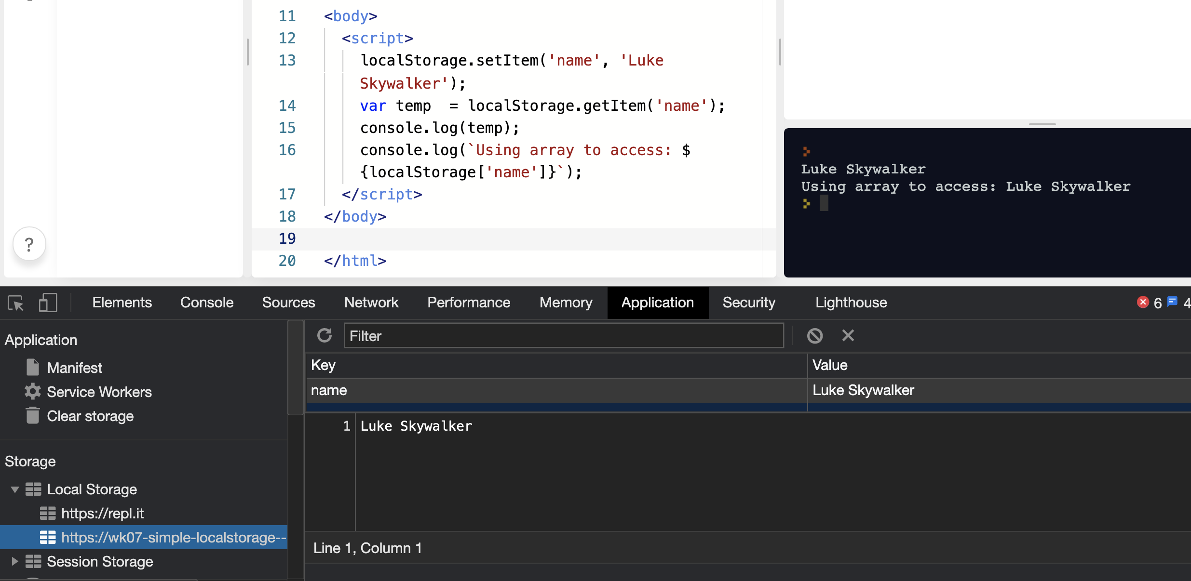
Official (Closed) - Non Sensitive
CHECKING WHETHER LOCALS STORAGE STORED IN CHROME BROWSER debugger
https://repl.it/@malcolmyam/wk07-simple-localstorage#index.html

Slide 16
Local Storage
Official (Closed) - Non Sensitive
Like other JavaScript objects, you can treat the localStorage object as an associative array (much easier).
Instead of using the getItem() and setItem() methods, you can simply use square brackets. For example, this snippet of code:
let foo = localStorage.getItem("bar");
....
....
localStorage.setItem("bar", foo);
let foo = localStorage["bar"];
....
....
localStorage["bar"] = foo;
==SAME==
https://repl.it/@malcolmyam/wk07-basic-localstorage#script.js
Notes:
https://repl.it/@malcolmyam/wk07-basic-localstorage#script.js

Slide 17
Official (Closed) - Non Sensitive
Accessing the storage API
Using setters/getters
Using the dot notation
//Store information
localStorage.setItem('age' , '12') ;
localStorage.setltem('color' , 'blue');
//Access information and store in variable
let age = localStorage.getItem('age');
let color= localStorage.getItem('color');
//Number of items stored let items= localStorage.length;
//Store information (object notation)
localStorage.age = 12;
localStorage.color = 'blue';
//Access information(object notation)
let age = localStorage.age;
let color= localStorage.color;
//Number of items stored let items= localStorage.length;

Slide 18
Official (Closed) - Non Sensitive
METHODS & PROPERTIES
METHOD
DESCRIPTION
setItem(key,value)
Creates a new key/value pair
getItem(key)
Gets the value for the specified key
Removes the key/value pair for the specified key
removeItem(key)
clear()
Clears all information from that storage object
PROPERTY
DESCRIPTION
length
Number of keys
Notes:
These are the common methods and property that local storage can tap on.
You can easily set or get items or remove items in the storage
The clear option clears all localstorage involved in the same domain.

Slide 19
WHAT ABOUT OBJECTS?
Official (Closed) - Non Sensitive
Notes:
Objects are tricky as they contain a chunk of information versus just one piece of information.
For arrays and objects, we would need to turn to json formatting.

Slide 20
DATA FORMATS JSON
Official (Closed) - Non Sensitive
#WEBSTORAGE
Notes:
JSON stands for JavaScript Object Notation
JSON is a lightweight format for storing and transporting data
JSON is often used when data is sent from a server to a web page
JSON is "self-describing" and easy to understand

Slide 21
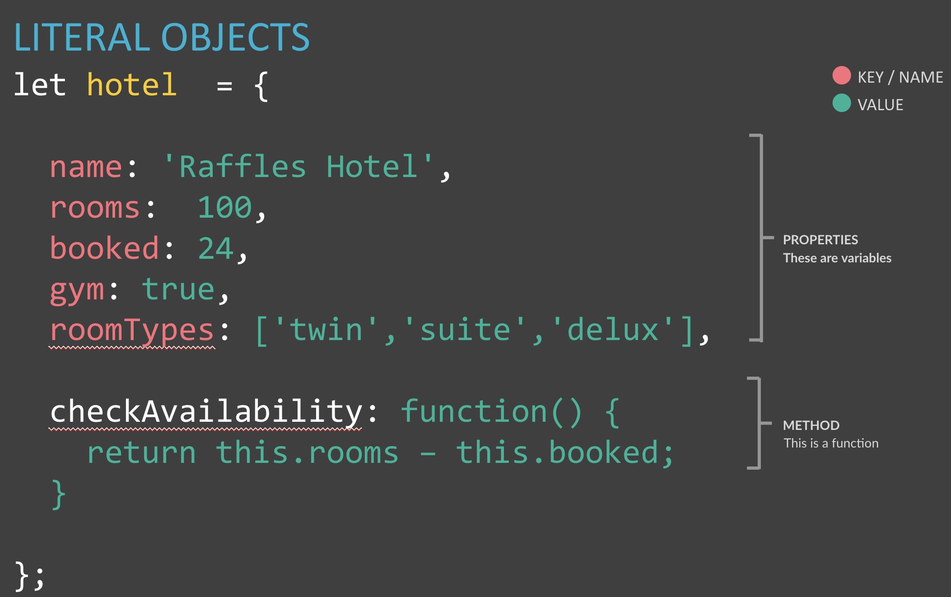
JSON looks like object literal syntax but it is just data, not an object:
{ "name": "Pikachu", "hp": 200, "attack": 999, "defense": 999, "type": "electric" }
Official (Closed) - Non Sensitive
https://www.w3schools.com/js/js_json_intro.asp
https://developer.mozilla.org/en-US/docs/Web/JavaScript/Reference/Global_Objects/JSON
Notes:
This is the JSON syntax. Prounced JASON
JSON is a syntax for serializing objects, arrays, numbers, strings, booleans, and null. It is based upon JavaScript syntax but is distinct from it: some JavaScript is not JSON.
Property names (in red) must be double quotated strings
You could have an array in JSON but it has to be in JSON syntax
Arrays in JSON
{
"employee":{ "name":"John", "age":30, "city":"New York" }
}
https://developer.mozilla.org/en-US/docs/Web/JavaScript/Reference/Global_Objects/JSON
https://www.w3schools.com/js/js_json_intro.asp
https://www.w3schools.com/js/js_json_datatypes.asp

Slide 22
{ "name": "Pikachu", "hp": "200", "attack": "999", "defense": "999", "type": "electric" }
Official (Closed) - Non Sensitive
JSON data is made up of keys and values:
In JSON, the key should be placed in double quotes (not single quotes).
The key (or name) is separated from its value by a colon.
Each key/ value pair is separated by a comma. However, note that there is no comma after the last key/value pair
KEY in double quotes
Unlike your typical literal objects
VALUE
Notes:
JSON is a type of data format that is versatile to use
JSON data format allows us to have more information stored into our localstorage

Slide 23
The value can be a string, number, Boolean, array, object or null. You can nest objects.
Official (Closed) - Non Sensitive

Slide 24


[ { "name":"Pikachu", "hp":100,"attack":9, "defense":8, "color":"yellow", "type":"electric" }, { "name":"squirtle", "hp":"47", "attack":"39", "defense":"38", "color":"blue", "type":"water" } ]
Official (Closed) - Non Sensitive
let pokemon =
NESTING OBJECTS with JSON
pokemon[0].name //pikachu
pokemon[1].name //squirtle
Image Source: http://pokemon.wikia.com/wiki/

Slide 25
JavaScript has a JSON object with two important methods: 1: Convert a JavaScript object to a string: JSON.stringify(); 2: Convert a string to a JavaScript object: JSON.parse();
Official (Closed) - Non Sensitive

Slide 26
JSON as long Strings (objects)
Official (Closed) - Non Sensitive
let contact = function (fname) {
this.firstName = fname;
};
let example = new contact('Johnny');
localStorage.setItem('user1', JSON.stringify(example));
localStorage.getItem('user1');??//object?
Parse it instead!
let exampleObj = JSON.parse(localStorage.getItem('user1'));
We use JSON.parse() to convert JSON into a Javascript object
https://repl.it/@malcolmyam/wk07-simplejson#script.js
https://www.w3schools.com/js/js_json_parse.asp
Notes:
https://repl.it/@malcolmyam/wk07-simplejson#script.js
https://www.w3schools.com/js/js_json_parse.asp

Slide 27
OBJECTS?
Official (Closed) - Non Sensitive
function Pokemon(name, hp, attack, defense, color, type) {
this.name = name;
this.hp = hp;
this.attack = attack;
this.defense = defense;
this.color = color;
this.type = type;
}
//let's create our base and store pikachu
let pikachu = new Pokemon("Pikachu", 100, 9, 8, "yellow", "electric");
//
let giantPokeBall = [];
giantPokeBall.push(pikachu);
localStorage.setItem("pokemonList", JSON.stringify(giantPokeBall));
//creates an array
let tempList = JSON.parse(localStorage.getItem("pokemonList"));
Image Source: http://pokemon.wikia.com/wiki/Pikachu

Slide 28
Clearing Storage
Official (Closed) - Non Sensitive
localStorage.clear();
localStorage.removeItem(<item key>);
https://repl.it/@malcolmyam/wk07-sample-obj-localstorage#script.js

Slide 29
STORAGE LIMITATIONS
Official (Closed) - Non Sensitive
Browser limitation 5 MB
Able to request the browser for more storage space
“QUOTA_EXCEEDED_ERR” is the exception that will get thrown if you exceed your storage quota of 5 megabytes

Slide 30
When Quota Exceeds?
Official (Closed) - Non Sensitive
#WEBSTORAGE #WK4
try {
localStorage.setItem(data.name,JSON.stringify(data));
} catch(domException) {
if (domException.name === 'QuotaExceededError' ||
domException.name === 'NS_ERROR_DOM_QUOTA_REACHED')
{
// Fallback code comes here.
}
}
Notes:
What to do when your quota exceeds 5mb or there’s an error ocurrence
Catch all the errors involved

Slide 31
ACTIVITY
“STORE Basic” (30min)
Follow the instructions below before starting the questions
https://replit.com/@immalcolm/form-localstorage
Either fork the repl.it or copy out the source code to your local machine
Based on the JS code in the HTML file, modify the TODO portion.
check whether there's local storage data 'username'
if there is, retrieve it and display first when the page is loaded
if not, set the localstorage item 'username' when the user submits the name
Download your final answer into your computer.
Sidenote: Use the browser’s debugger or repl.it console for quick testing
SUBMISSION
Simply download and save your own codebase

Slide 32
ACTIVITY
“STORE Advanced” (20min)
Follow the instructions below before starting the questions
https://replit.com/@immalcolm/form-obj-localstorage
Either fork the repl.it or copy out the source code to your local machine
Follow the README.md file to start on your project
Sidenote: Use the browser’s debugger or repl.it console for quick testing
Look at how the pokemon code is done :)
SUBMISSION
Simply download and save your own codebase

Slide 33
Sample Codes
Local Storage
Basic Local Storage example
https://replit.com/@Jian_Ting_Donov/localStorage-Simple
Advanced Local Storage with combined use of JSON data
https://replit.com/@Jian_Ting_Donov/localStorage-Advanced

Slide 34


Local Storage
Summary
What have we covered?
JSON
LocalStorage
ID

Slide 35
JS Basics
Key Takeaway?
Practise & Practise
The usage of localstorage and JSON is versatile and can be applied to create and develop more complex applications. A simple example is a Create, Read, Update & Delete (CRUD) system, like a to-do list that persist even when you close the browser
ID

Slide 36
TIDBITS
Official (Closed) - Non Sensitive

Slide 37
Official (Closed) - Non Sensitive
http://www.html5rocks.com/en/tutorials/offline/whats-offline/
https://developer.mozilla.org/en-US/docs/Web/JavaScript/Introduction_to_Object-Oriented_JavaScript
http://www.html5rocks.com/en/tutorials/offline/quota-research/

